Slide 1
Localstack w/ Docker & Terraform for Integration Tests
Talha Altinel

Slide 2
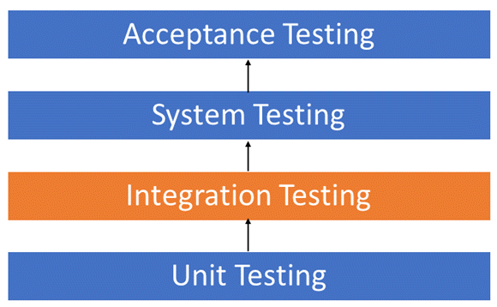
Intro
Localstack is a testing/mocking framework for developing Cloud applications locally. Where in theory, you can stick any AWS service and emulate them in localhost without ever needing the real AWS account.
Localstack’s primary goal to make integration/system testing less painful for developers.

Slide 3
In theory?
There are many AWS services(some of them are buggy as people in Localstack’s slack channel claim) which are not completely provided by AWS directly.
For the scope of PoC, We will be only focusing most popular and stable ones like lambdas, kinesis and dynamodb in this presentation and draw general conclusions from it.
Requirements for this are to have Go, docker, docker-compose, aws CLI and terraform. In practice, we are planning to use 3 lambdas, 3 kinesis streams and 1 dynamo table.

Slide 4
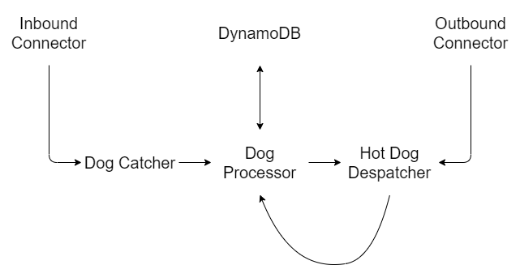
What are we building?
No dogs are harmed in this process

Slide 5
Steps to quick start
Running latest version via docker (best preferred way is to do this via docker-compose where I provided the file for it):
docker run --rm -it -p 4566:4566 -p 4571:4571 localstack/localstack
docker-compose up -d --build
Note: Check all of the container env settings variables from docker hub, other pages seem to be not up to date.
Please note: Starting with version 0.11.0, all services are exposed via a single edge service endpoint. Below 0.11.0 version, each AWS service is exposed by different port.
- http://localhost:4566 by default.
Please note: Web UI dashboard is deprecated. Avoid using it if possible.

Slide 6
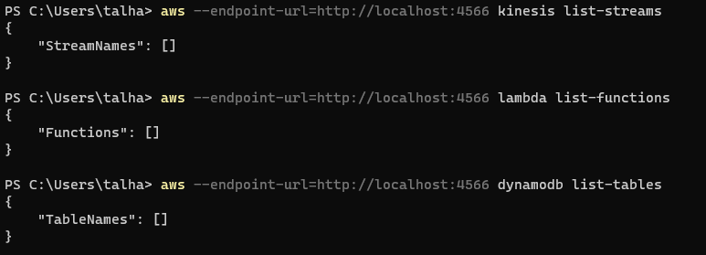
Then What? Does it work?

Slide 7
Clone my repo
Localstack PoC repository:
git clone https://github.com/MrWormHole/hotdog-localstack-PoC
docker-compose up -d --build
terraform init
terraform apply --auto-approve
aws lambda invoke --function-name dogCatcher --endpoint-url=http://localhost:4566 --payload '{"quantity": 5}' output.txt

Slide 8
LIVE DEMO!
Praying on demo gods

Slide 9
Localstack reduce deploy and debug time and costs significantly

Slide 10
Localstack Slack Community is very active and helpful

Slide 11
Localstack is quite easy to integrate into CI/CD(dev/uat) or anywhere

Slide 12
There are no debugger attachments for deployed code(exes)

Slide 13
Localstack is still new, yet promising. But there can be breaking changes in the future

Slide 14
Integration testing is not for everyone.

Slide 15

References
The localstack gang from localstack slack channel
Baptiste Bouchereau’s Blog
Terraform Docs

Slide 16


Thanks!

